Slide 1

Quick Quiz
An I-On Project
Participants:
Vitor Mexia 36070
Tiago Carvalho 36080
Supervisor:
Prof. Pedro Félix

Slide 2

What is I-On?

Slide 3




I-On project
I-On is an open-source academic project that is an information aggregation and distribution system, and with Quick Quiz, also a utility platform oriented for academic usage.

Slide 4
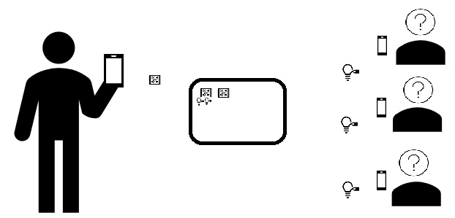
Quick Quiz
Quick Quiz is a project to promote the interaction between professors and his students during class by providing a way for a teacher to present questions (quizzes) which the students can then answer anonymously.

Slide 5
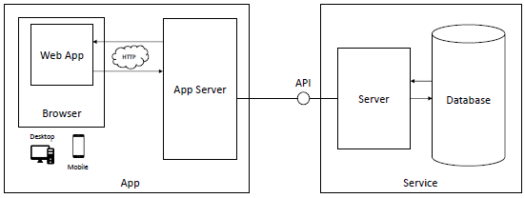
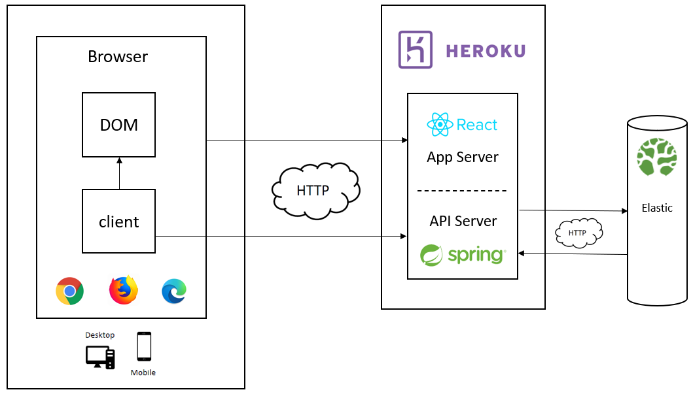
Architecture
Quick Quiz quiz initial architecture proposal evolved to having the App and API Server in the same place. This change allows us to use cookies for authentication by the atributes same-site and http-only ....
Same-site: restricts cookies from being sent with outside requests
Http-only: prevents client-side scripts from accessing data from the cookie

Slide 6

Progress

Slide 7




API Definition and repository structure Apr. 10th to 23rd
Highlights
Define Api Entry points
Define Elasticsearch data structure
Define Input/output models
Challenges
Connect requirements with API definitions
Learning Spring Boot
Learning Spring Data Elasticsearch
Learning YAML

Slide 8

API Definition and repository structure Apr. 24th to May 13th
Highlights
Redefine Exception Output model to use Problem+JSON
Redefine Output model to use JSON Siren
Implement remaining API entry points
Implement Authentication
Start Frontend implementation
Challenges
Learning Problem+JSON
Learning JSON Siren
Learning React

Slide 9
API Definition and repository structure Apr. 14th to May 27th
Highlights
Implement all major features in website
Implement websockets
Improve API where needed
Challenges
Learning React
Learning websockets
Yet unknown roadblocks

Slide 10


API Definition and repository structure Apr. 28th to June 3rd
Highlights
Deploy to Heroku (dev/staging environment)
Prepare Demo
Start implementing extra functionality
Challenges
Learning Heroku
Learning how to use Heroku-Bonsai
Yet unknown roadblocks

Slide 11
Register/Login workflow

Slide 12

Elasticsearch structure
A user has a single document on the ‘users’ index and multiple documents on ‘sessions’, ‘templates’ and ‘history’ indexes.
A session has multiple quizzes which in turn can have multiple answers.
A participant has a single document with all their answers for the quizzes in a session.
Users
Sessions
Quizzes
Templates
History
Answers

Slide 13
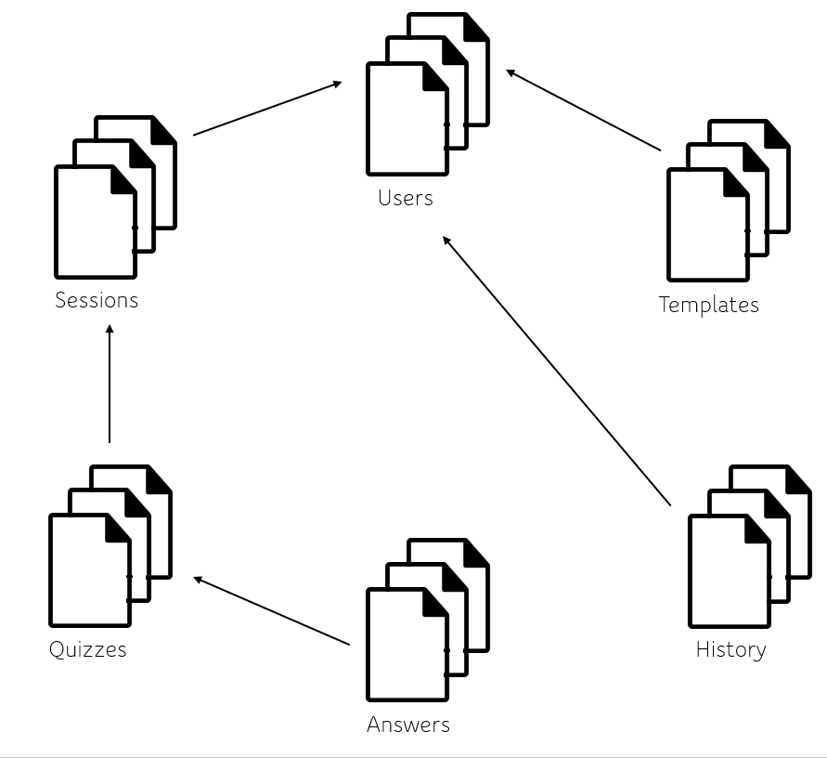
A user has a single document on the ‘users’ index and multiple documents on ‘sessions’, ‘templates’ and ‘history’ indexes.
A session has multiple quizzes which in turn can have multiple answers.
A participant has a single document with all their answers for the quizzes in a session.

Slide 14
Elasticsearch structure
Users
Sessions
Templates
Quizzes
History
Answers

Slide 15
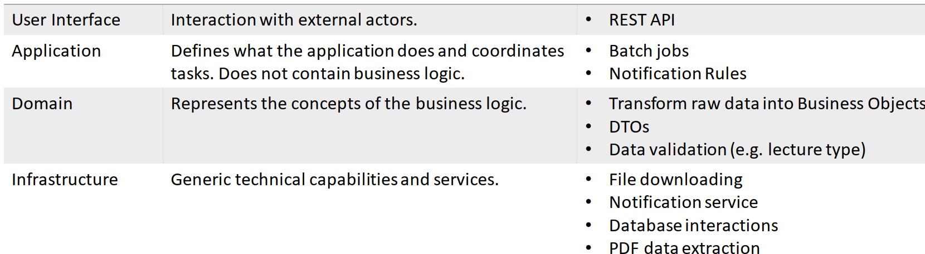
Definitions (exemplo) =>

Slide 16
What next (June/July)

Slide 17
Q&A Thank You

